Slide 1
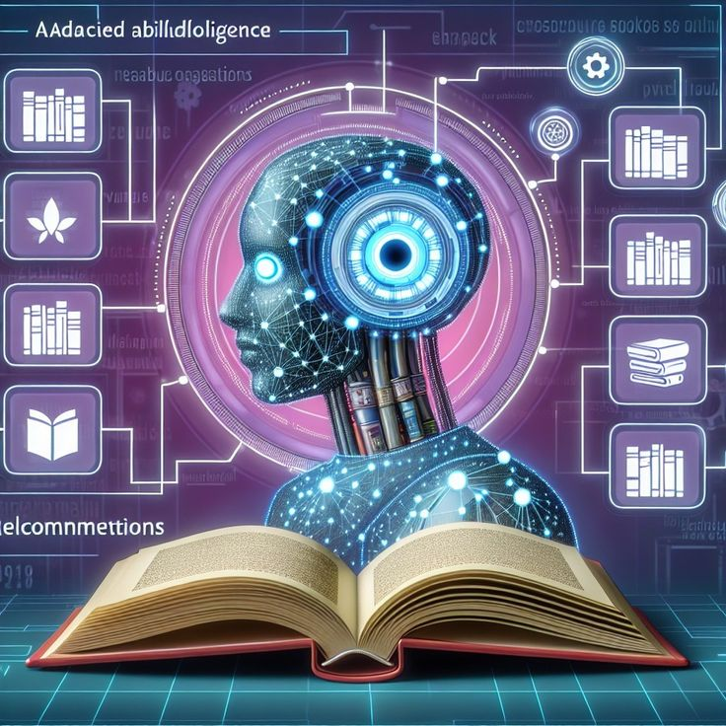
AI BOOK FINDER
BOOK FINDER
A Prolog-Based Book Recommendation System
A Prolog-Based Book Recommendation System

Slide 2

Group Members
M.T.Imaya Mathugama
A.M.N.Y.Amarakoon
H.K.C.D.Wijethilake
H.D.K.H.Jayasinghe
K.A.D.M.Harshi
K.S.A.Frenando

Slide 3

What Is This Project?
An AI chatbot built in prolog to help users find books by category genre and year range.
A simple rule-based expert system developed in Prolog.
It recommends books to users based on,
Category (ex: Fiction,fantacy..)
Genre (ex: Thriller,drama..)
Publication year range

Slide 4

Importance of AI Book Finder
Personalized Suggestions
Time-Saving
Interactive User Experience
Educational Value
Automation of Book Search
Data Filtering Capability
Scalable System Design
Helps Non-Technical Users
Use Case for Libraries/Stores
Supports Multiple Criteria Search

Slide 5

Demonstration: AI Book Finder on SWI-Prolog
Step 1:
Open SWI-Prolog
Step 2:
Load the Program
Step 3:
Start the Chatbot

Slide 6

Step 4:
Provide Input When Prompted
Step 5:
View Results
Step 6:
No Match Example

Slide 7
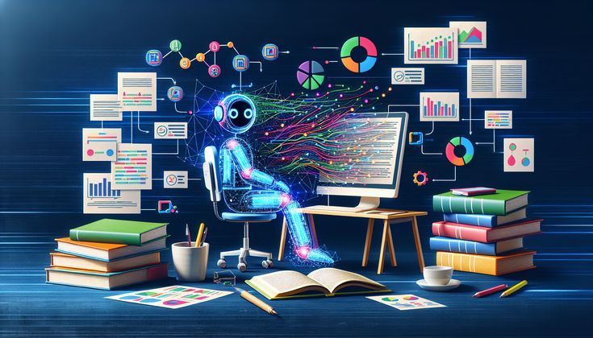
Live Output Sample
Welcome to the AI Book Finder!
What category are you interested in?
|: fantasy
What genre do you prefer?
|: adventure
What is the minimum release year?
|: 1900
What is the maximum release year?
|: 2000
Title: The Hobbit
Author: J.R.R. Tolkien
Year: 1937

Slide 8
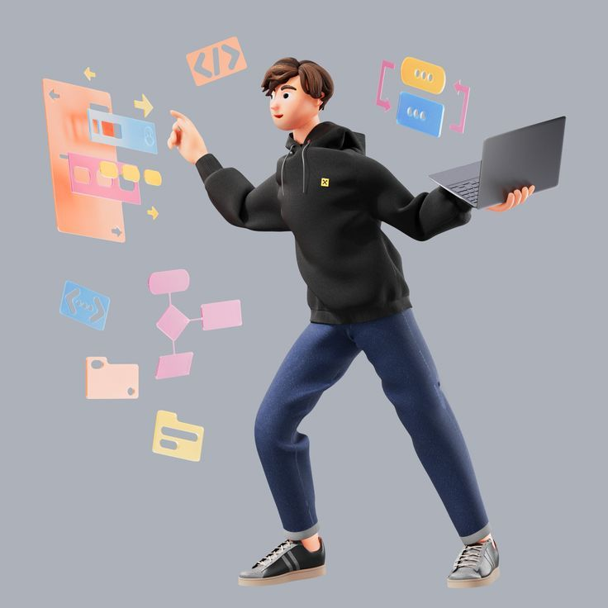
How This Chatbot Works? (System Flow)
Start the Chatbot
Collect User Preferences
Category (ex: fiction, fantasy, mystery)
Genre (ex: thriller, classic, magic)
Minimum Year (ex: 1937)
Maximum Year (ex: 2020)
Search the Book Database
Display Results
End the Programme

Slide 9

Flowchart Summary
[Start]
↓
[Ask Preferences]
↓
[Filter Books with Logic Rules]
↓
[Display Results or Message]
↓
[End]

Slide 10

Problems and Issues
Limited Dataset
Rigid Input Format
Lack of Personalization
No Ranking or Recommendation
No Synonym Support
Not Scalable
No GUI Interface
Language Limitation
No Error Handling
Static Results

Slide 11
Future Enhancements of AI Book Finder
Expand Book.
Natural Language Processing (NLP).
Personalized Recommendations.
Add Ranking.
User Interface (UI).
Mobile Compatibility.
Support for Multiple.
Voice Interaction.
Synonym and Fuzzy Matching.
User Account System.

Slide 12

Thank You
Have Any Questions?

